Slide 1

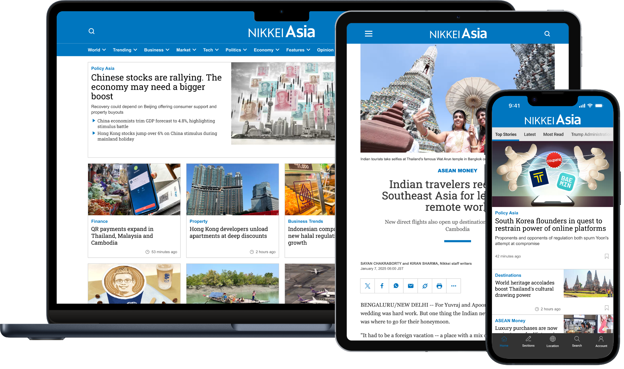
Toyo University
Registration Guide

Slide 2
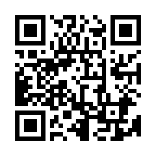
Registration Guide
All students and faculty members of Toyo University can register for Nikkei Asia via the link or QR code below.
Please register using your university email address (@toyo.jp, @iniad.org) to create your Nikkei Asia account.
Dedicated registration link for Toyo University
https://asia.nikkei.com/?contractId=TMV8EL4TXY7P
Access from your smartphone

Slide 3
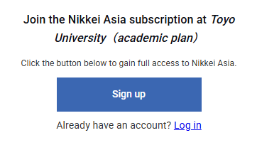
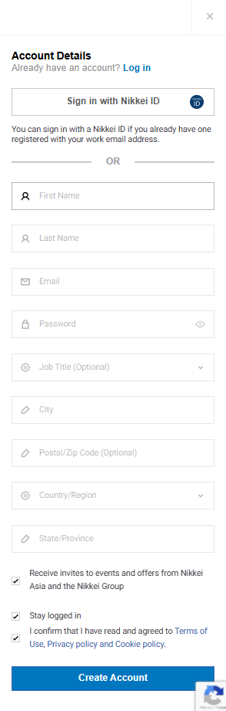
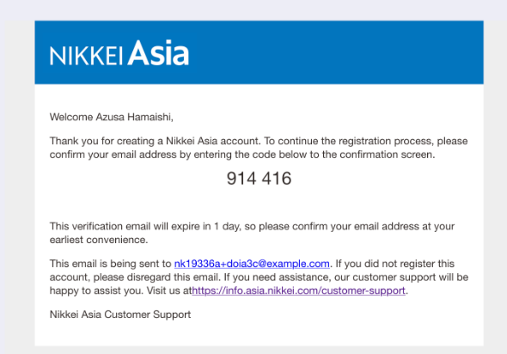
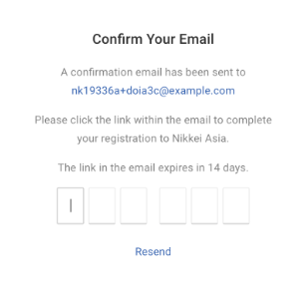
How to create an account
②
① Access the link below:
https://asia.nikkei.com/?contractId=TMV8EL4TXY7P
② Once the pop-up appears, click the “Sign up” button.
(* If you already have a Nikkei Asia account registered with your university email address, please log in by clicking the [Log in] link below the button. Access will be granted automatically.)
③ Fill in the form and click ”Create Account”
*Please make sure to use your university email address (@toyo.jp, @iniad.org) when registering.
* Please fill in your name, email address, password, role (select "Student"), country/region, and City. (Other fields are optional.)
④ A 6-digit code will be sent to your email address.
Please check your inbox and enter the code to complete the registration.
③
④
④

